Slide 1
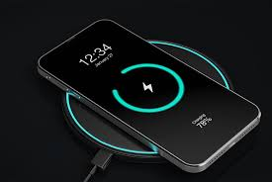
Wireless mobile charger

Slide 2
Contents
Motivation
Circuit Diagram
Working Principle
Specifications
Functionality Justification
Results
Challenges
References

Slide 3

Motivation
Charge a mobile phone battery with no physical connection between transmitting and receiving device.
This project main objective was to enhance knowledge and to construct a wireless charging pad for a mobile

Slide 4
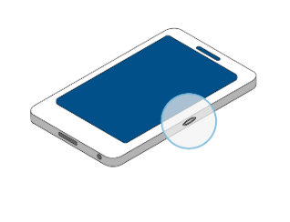
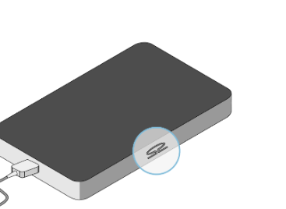
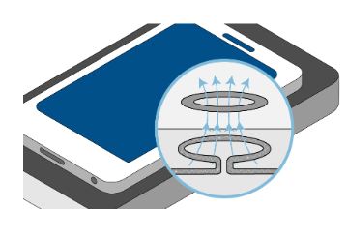
How does it work?
Inside your smart phone is a receiver induction coil made of copper.
The wireless charger contains a copper transmitter coil
When you place your phone on the charger, the transmitter coil generates an electromagnetic field that the receiver converts to electricity for the phone battery. This process is known as electromagnetic induction.

Slide 5
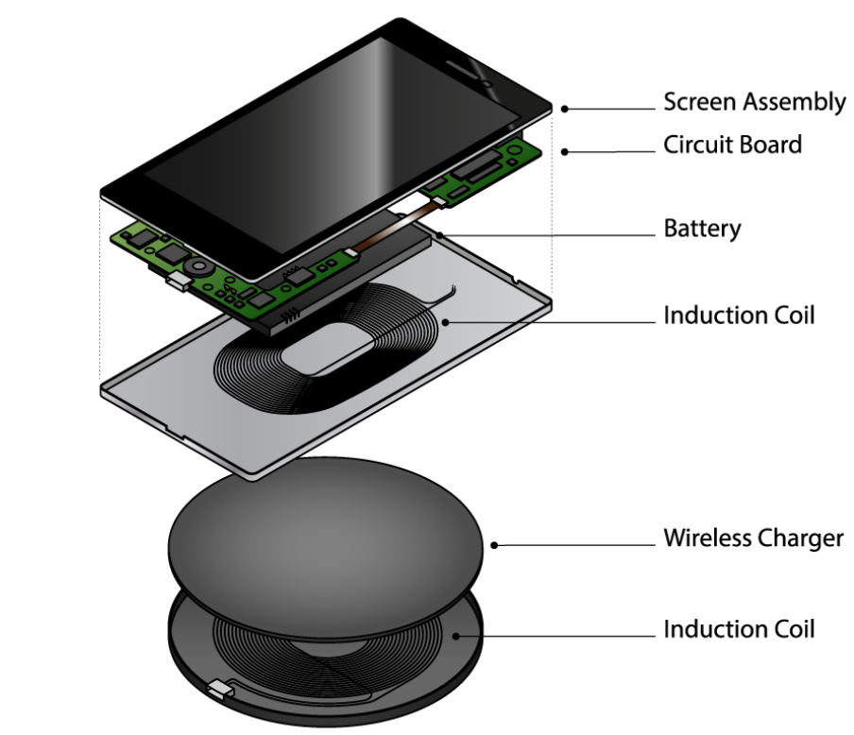
Inside view of Mobile for charge

Slide 6
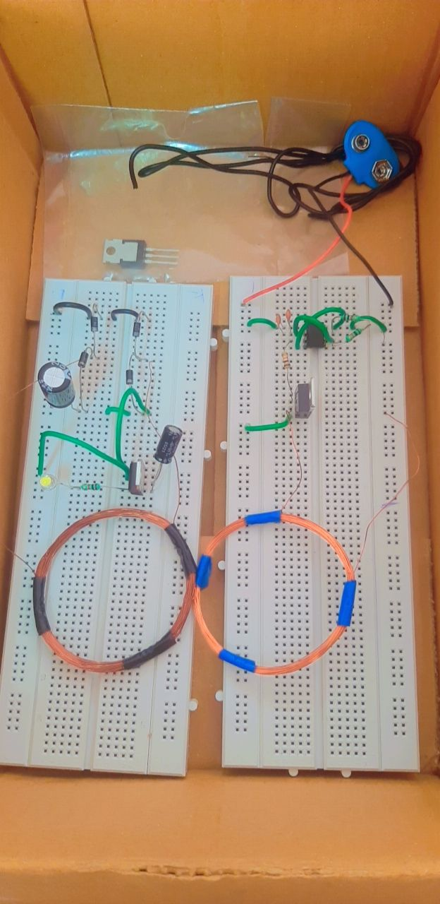
Circuit Connections on Breadboard

Slide 7
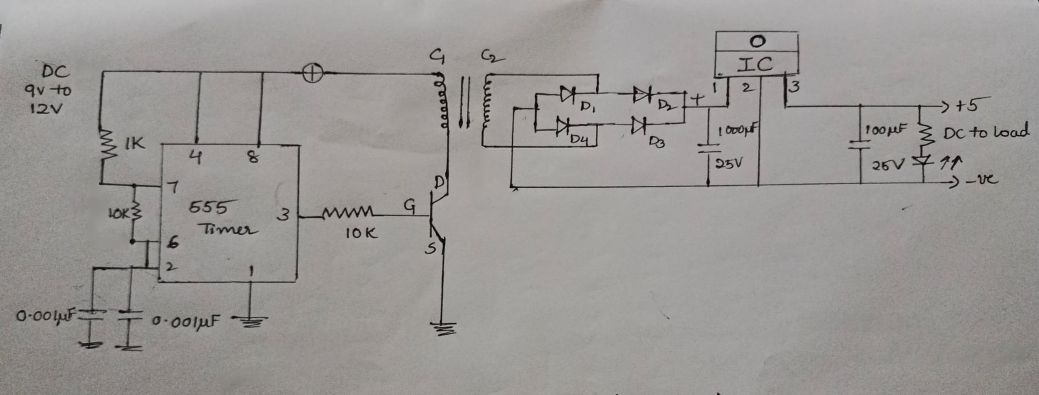
Circuit diagram
Transmitter side
Receiver side

Slide 8
Working Principle
Power is transferred from transmitter to the receiver wirelessly based on the principle of “Inductive Coupling"
This is because, as the current is flowing in the conductor, a magnetic flux is induced in it.
This induced magnetic flux links with another conductor and this flux induces voltage in the second conductor
Thus two conductors are said to be inductively coupled.

Slide 9
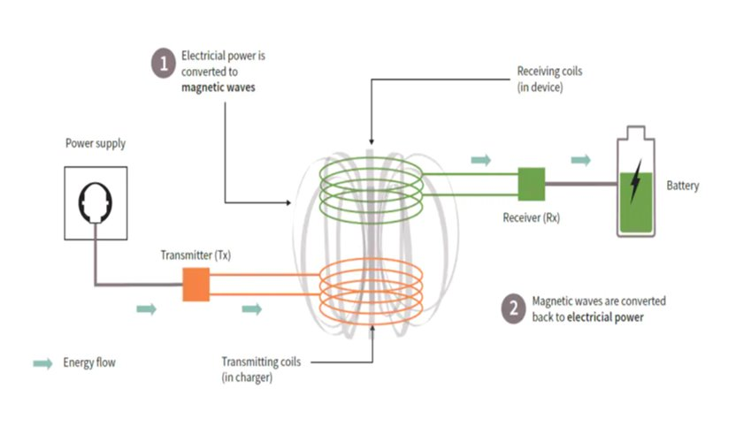
Power Transfer Diagram

Slide 10
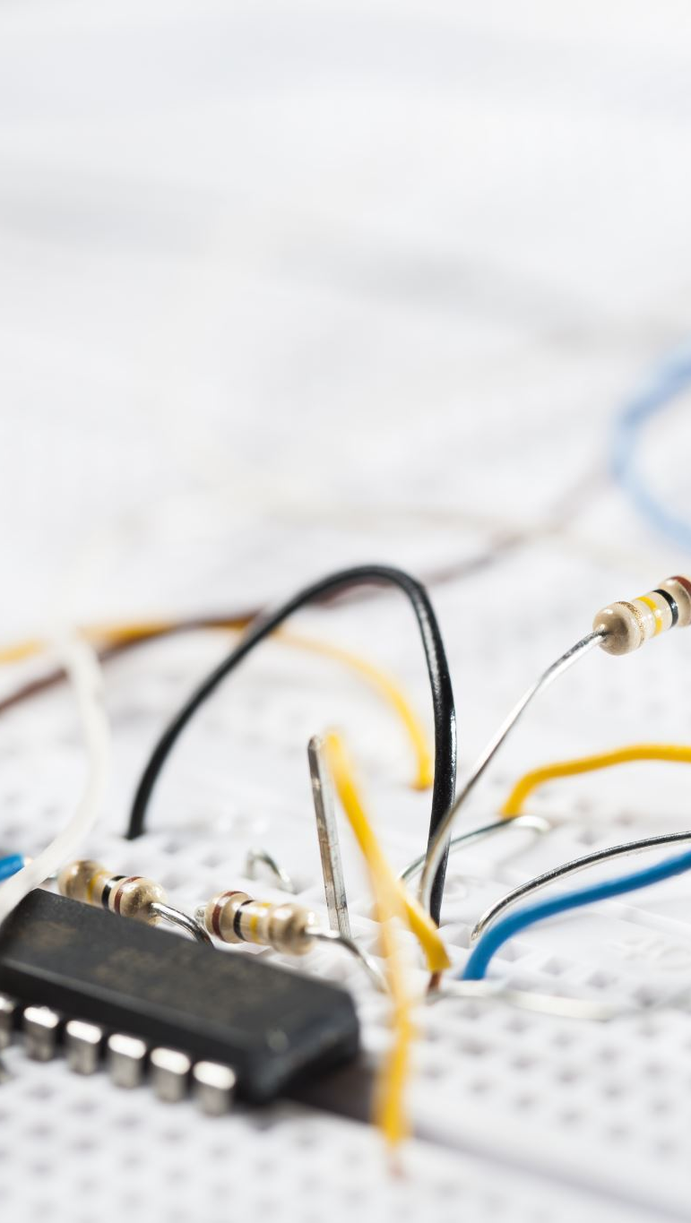
Specifications
MOSFET -IRF244 (NPN Transistor)
Diodes - IN4007
Capacitor – 0.001µF, 1000µF, 0.001µF, 100 µF
Resistors-1Kohm,10Kohm,10ohm
Voltage regulator - 7805IC
Battery-5v (DC Input)
Copper wires
555 timer
Connecting wires
LED
Bread board – 2(Transmitter ,Receiver side)
Mobile
USB port

Slide 11
Justification of the rating
Mosfet: used for switching operation
Diodes: bridge rectifier circuits for current conduction
555Timer: produces pulses using timing components such as resistor and capacitor
Coil: used for inductive coupling between transmitter and receiver side
Voltage regulator: gives output voltage of 5v DC which can be regulated
Connecting wires: for connection
Battery : for power supply
Bread board: to hold components that are wired together
Range: Near-field

Slide 12
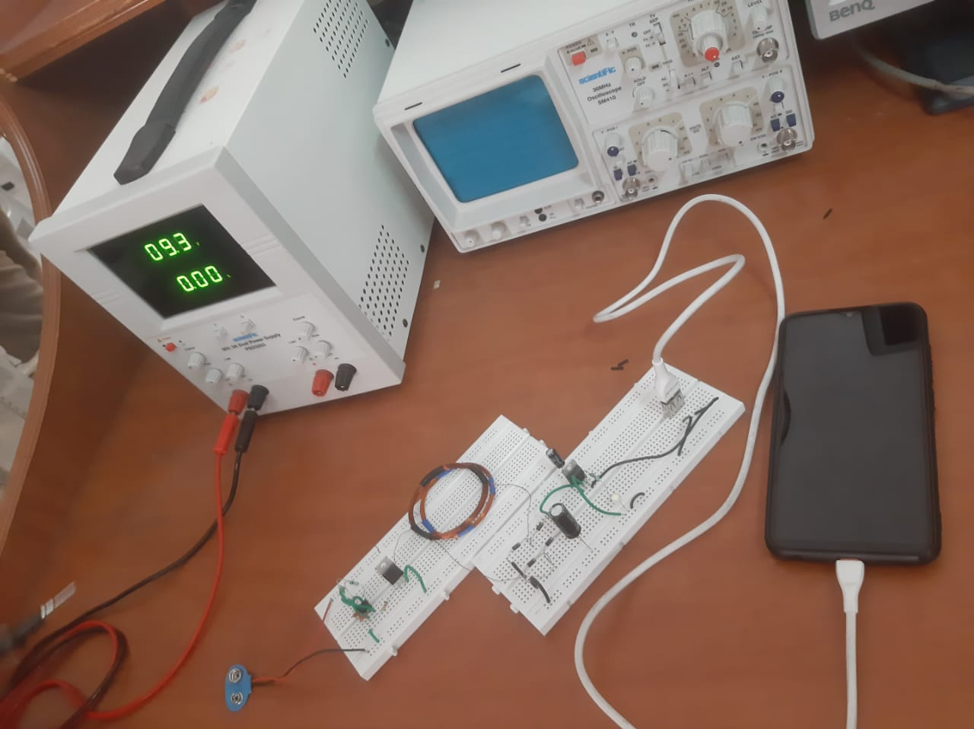
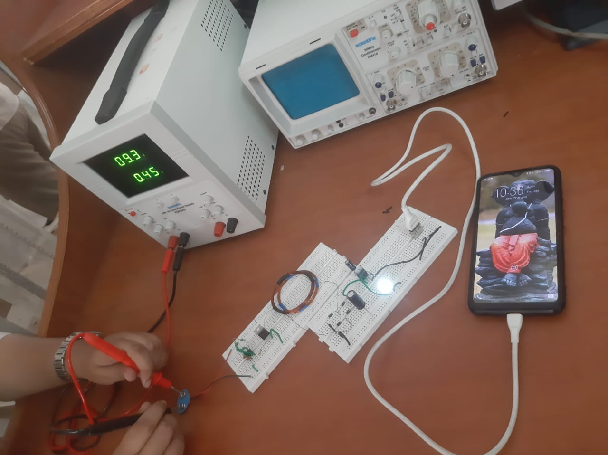
Without power supply
With power supply

Slide 13
Results
Implemented using hardware components for near field wireless power transfer
Circuit design is done
Bread board connections are done
Mobile is charging successfully for 9V Supply

Slide 14

Challenges
Not possible for long distance (far field)
They're Slow. Using a wireless charger is not as fast as a wired charge
Continued exposure to heat can result in battery damage (inefficient)

Slide 15
References
https://arxiv.org/pdf/1509.00940.pdf
https://www.researchgate.net/publication/267695945_Wireless_Charger_Networking_for_Mobile_Devices_Fundamentals_Standards_and_Applications
https://ieeexplore.ieee.org/document/8397783
https://www.sciencedirect.com/science/article/pii/S2352146521004610
https://www.instructables.com/DIY-Wireless-Charger/
wireless charger networking

